Slide 1

Cognitive Computing
Conversational Commerce

Slide 2
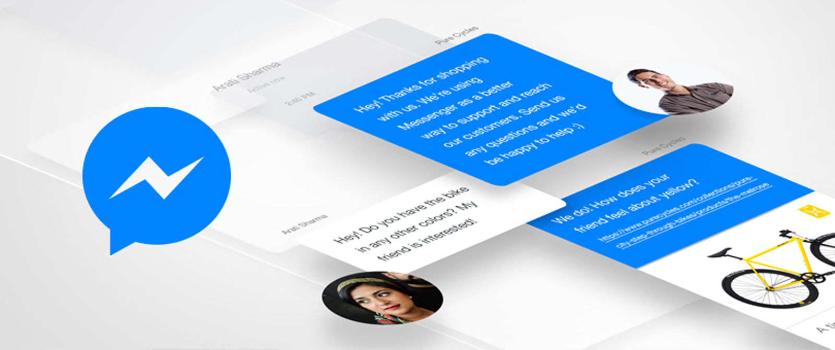
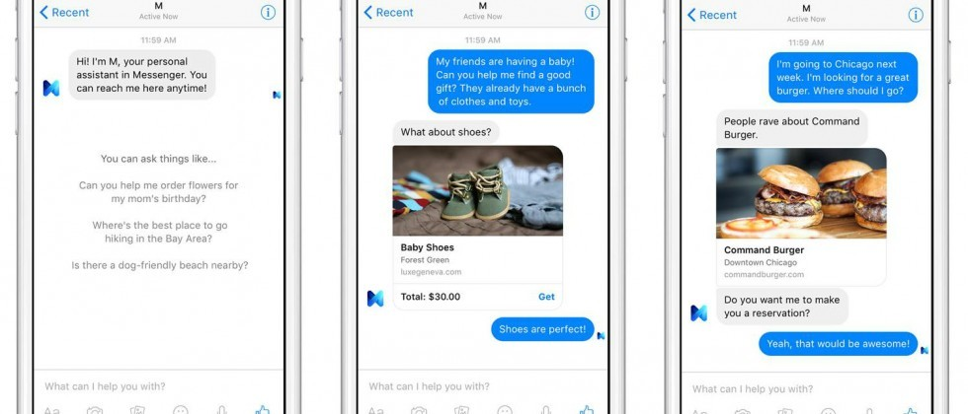
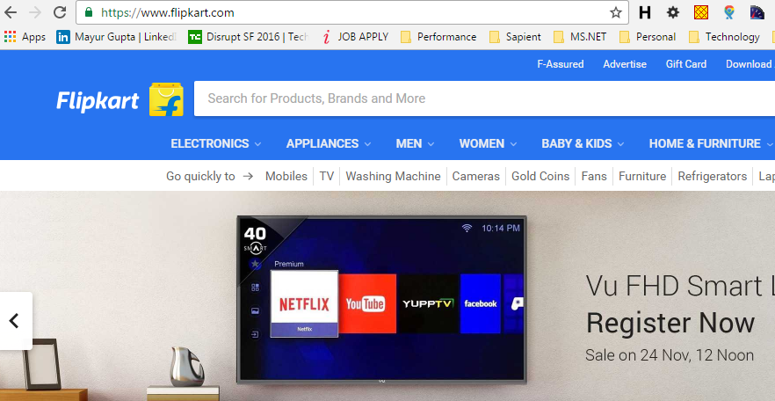
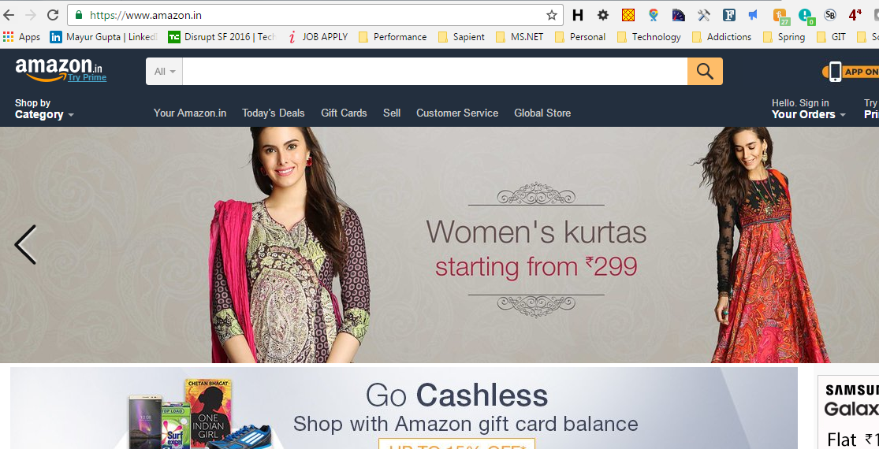
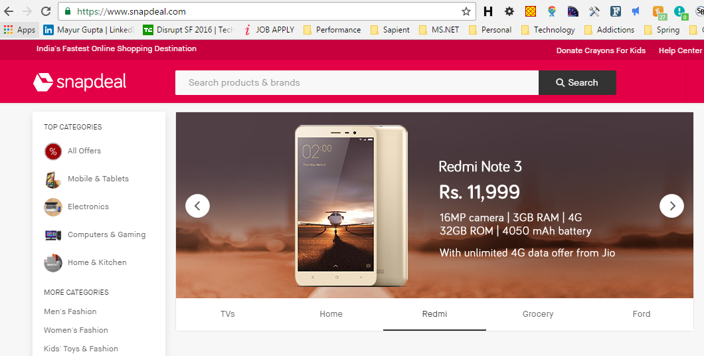
Conversational Commerce
Traditional
Ways
of online
shopping

Slide 3




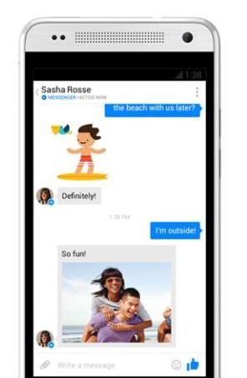



Conversational Commerce (Cont’d)
PAYMENT
CUSTOMER SUPPORT
SHOP
SHIPPING
SEARCH
DELIVERY

Slide 4
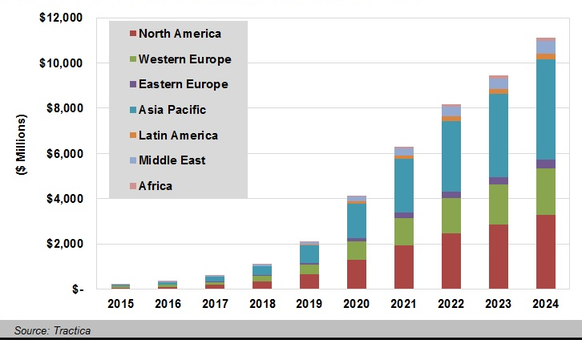
Conversational Commerce (Cont’d)
Forecast Conversational Commerce Revenue by Region World Markets 2015-24.

Slide 5

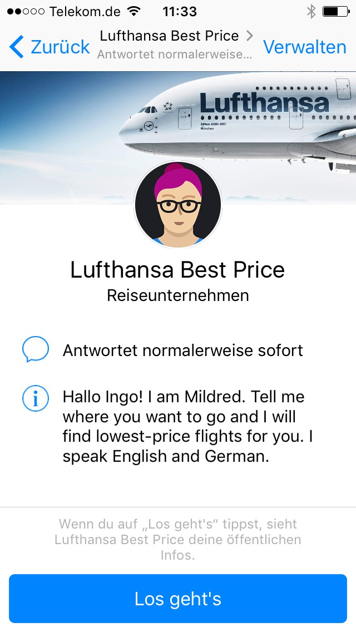
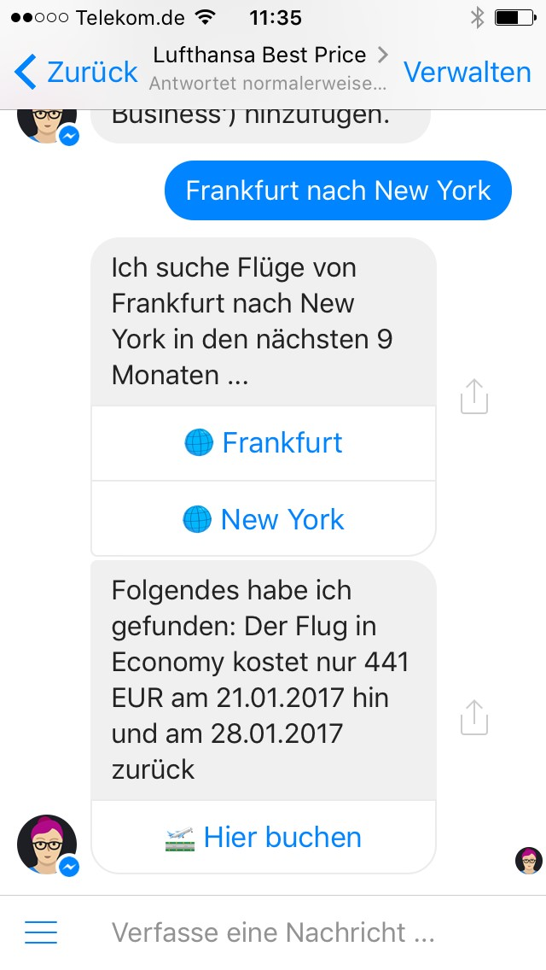



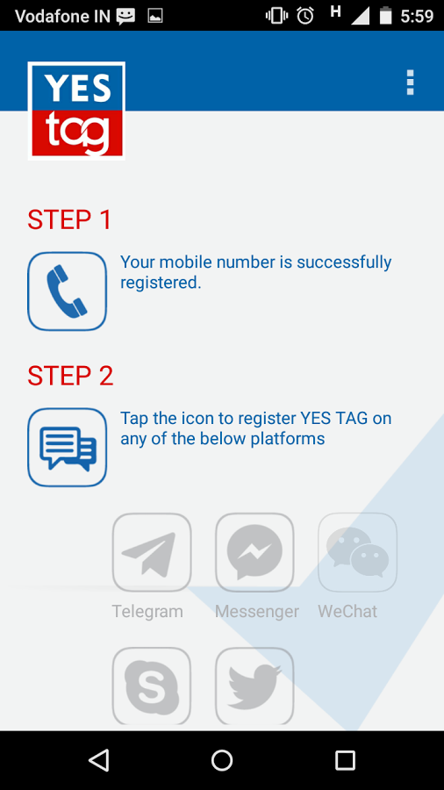
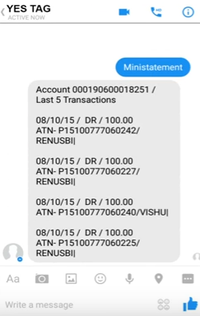
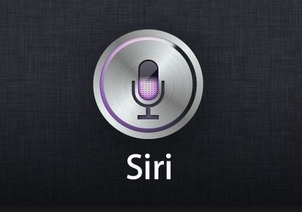
Conversational Commerce (Cont’d)
Shop Anywhere, Anytime
Ease of shopping / ordering
Interactive Experience
Necessary to adopt
Expansion Opportunity
Business Automation
Notes:
Consumers can :
Click to purchase all from within messaging apps.
Chat with company representatives
Get customer support
Get personalized recommendations
Businesses can:
Enable consumers to buy from them using everyday messaging app
Automate customer ordering and service messages process

Slide 6

Conversational Commerce – Questions ?
Who is responding from business side?
How is this different from live chat on commerce web?
Need more people for call center for chats?
What if I don’t have FB Msgr?
Different people have different dialect, language, pitch etc.?

Slide 7

Conversational Commerce
HOW ?

Slide 8
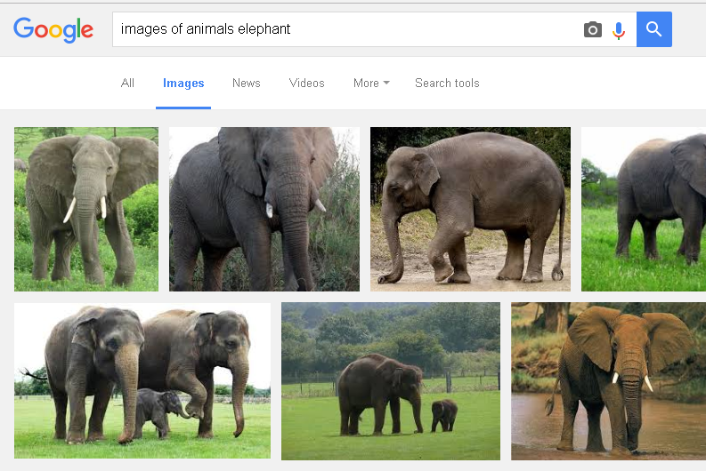
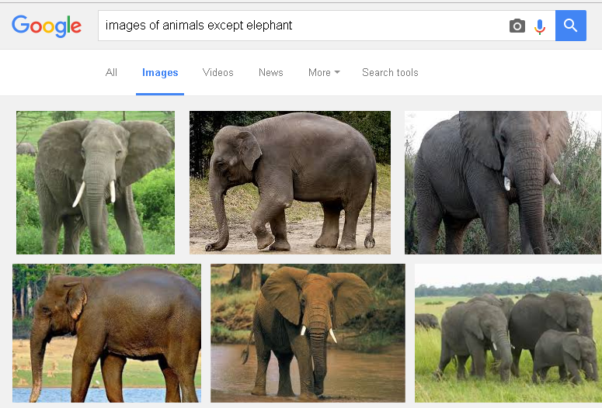
Cognitive Computing

Slide 9

Cognitive Computing

Slide 10
Cognitive Computing (Cont’d)
Mimics functioning of human brain
Understands Natural Language
Adapts and Learn
Generates and evaluates Hypothesis
Human-computer interaction
Natural language processing (NLP)
Reasoning
Machine learning

Slide 11






Cognitive Computing – Basic Building Blocks
CHAT
INSTANT MESSAGING
VOICE RECOGNITION
SMART AGENT
TWEET
eMAIL
NATURAL LANGUAGE PROCESSING (NLP)
ARTIFICIAL INTELLIGENCE
CHANNEL TRANSLATOR/BOT ENGINE
NATURAL LANGUAGE GENERATION (NLG)
MACHINE LEARNING
CONTEXT MANAGEMENT
BUSINESS LOGIC COMMERCE ENGINE
SYSTEMS OF RECORDS
Natural Language Generation (NLG)

Slide 12
Cognitive Computing – Basic Building Blocks
CHAT
INSTANT MESSAGING
VOICE RECOGNITION
SMART AGENT
TWEET
eMAIL
NATURAL LANGUAGE PROCESSING (NLP)
ARTIFICIAL INTELLIGENCE
CHANNEL TRANSLATOR/BOT ENGINE
NATURAL LANGUAGE GENERATION (NLG)
MACHINE LEARNING
CONTEXT MANAGEMENT
BUSINESS LOGIC COMMERCE ENGINE
SYSTEMS OF RECORDS
Natural Language Generation (NLG)

Slide 13
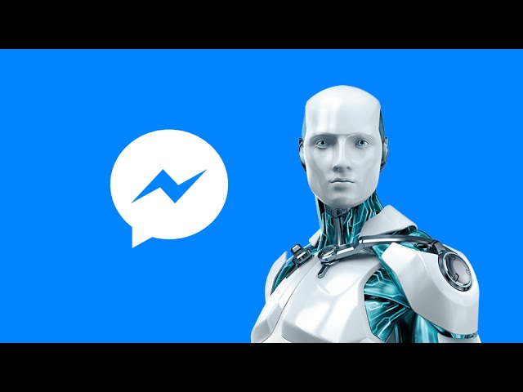
CHATBOT IN ACTION

Slide 14
Conversational Commerce – Questions ?
Who is responding from business side?
Who is responding from business side?
How is this different from live chat on commerce web?
How is this different from live chat on commerce web?
Need more people for call center for chats?
Need more people for call center for chats?
What if I don’t have FB Msgr?
What if I don’t have FB Msgr?
Different people have different dialect, language, pitch etc.?
Different people have different dialect, language, pitch etc.?

Slide 15

Questions & Answers

Slide 16
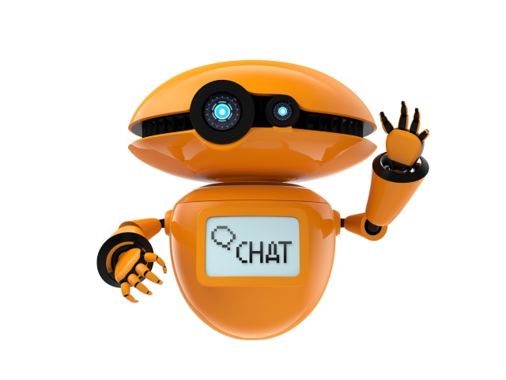
References
Visit us at:
Sapient Vox Innovatus Page
https://vox.publicis.sapient.com/groups/innovatus
Sources:
API.AI (https://api.ai/)
Microsoft bot framework (https://dev.botframework.com/)
Facebook Developers‎ (https://developers.facebook.com)
IBM Watson (http://www.ibm.com/watson/)

Slide 17
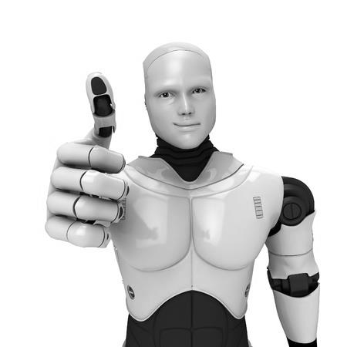
THANK YOU
Saurabh Ailawadi Shivam Chawla

Slide 18
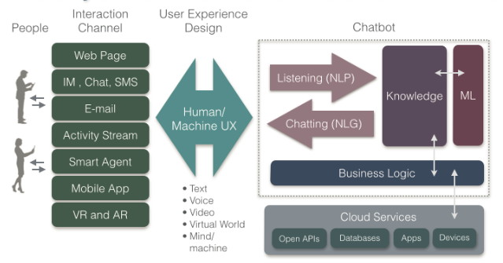
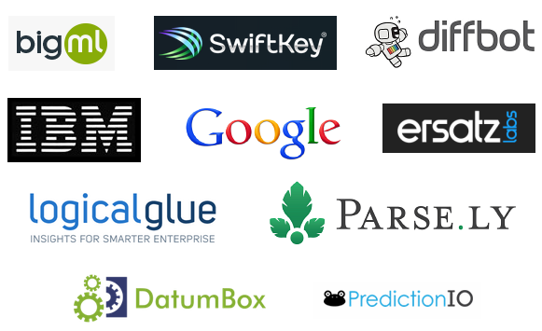









Cognitive Computing – Chatbot Architecture
NLP : Natural Language Processing
NLG: Natural Language Generation
ML: Machine Learning

Slide 19

Conversational Commerce
FIX this slide…
Simulation of human thought processes in a computerized model
Mimic the way the human brain works.
Chatbot
Human-computer interaction
Natural language processing (NLP)
Reasoning
Machine learning

Slide 20
Conversational commerce – Basic Building Blocks
CHAT
INSTANT MESSAGING
VOICE RECOGNITION
SMART AGENT
TWEET
eMAIL
NATURAL LANGUAGE PROCESSING (NLP)
MACHINE LEARNING
CHANNEL TRANSLATOR
NATURAL LANGUAGE GENERATION (NLG)
ARTIFICIAL INTELLIGENCE
CONTEXT MANAGEMENT
BUSINESS LOGIC COMMERCE ENGINE
SYSTEMS OF RECORDS
Natural Language Generation (NLG)

